Slide 1


Introducing
Nationwide Group Staff Union

Slide 2

About NGSU
Independent TUC Affiliated Trade Union
NGSU is a ‘staff’ union
Around 12,000 members
54 years within NBS
No political affiliation or donations
Dedicated to Protecting Members’ Interests
Negotiating Terms and Conditions
Help and Advice at Work
Individual Representation
Benefits and Discounts

Slide 3
Independent Advice At Work
We provide an independent view about employment issues to our members. We also help and support individual members with any problems they may encounter at work
Including:
Pay & Benefits
Terms & Conditions
Performance, End of Year Appraisals Appeals & Ill Health Meetings
Disciplinary & Request for Resolution (RfR)
Change Programmes, Flexible Working Requests & Appeals
End of Probation Review

Slide 4

What Have The Unions Ever Done For Us?

Slide 5
What Has NGSU Done For Us?
Support & Emergency Leave - gives you up to 5 days paid leave each calendar year (pro-rated for parttime employees) to help you with caring responsibilities for dependents of all ages, or to deal with domestic emergencies.
Compassionate Leave – When someone you’re close to is seriously ill, you can take compassionate leave. This is normally up to twenty days’ paid leave for both types of leave (pro-rated if you’re part-time).
Pension – Nationwide will contribute 10% regardless of your contribution & up to
13%
Holidays – 30 days holiday after 5 years of service

Slide 6
What Has NGSU Done For Us?
Time Off for Medical and Dental Appointments - When you can’t arrange to make medical/dental appointments outside of your work hours Nationwide allows you to take a reasonable amount of paid time to go to appointments without making up the time.
Paternity Leave – 13 weeks paid leave
Maternity Leave – 26 weeks full pay, 13 weeks SMP
Sick Pay – full pay for 6 months, ½ pay for 6 months & Group Income Protection plan (if eligible)
BUPA Healthcare – for everyone

Slide 7
Join Us Today – Together We Are Stronger
Monthly Subscription Fee - @ Jan 2026
Full Time Staff £12.40 p/m
Part Time Staff (16+ hours) £6.80 p/m
Part Time Staff (-16 hours) £5.30 p/m
Maternity & Pensioners £2.90p/m
How do we compare? - @ Jan 2026
Unite = £18.16 F/T p/m £10.92 P/T p/m
GMB = £15.18 F/T p/m £8.57 P/T p/m
Unison = up to £22.50* p/m
*Linked to salary – rates shown based on equivalent salaries in NBS.

Slide 8

Monthly Subscription Draw
Available To Members Only…
First Prize Of Up To £15,000
Second Prize Of £5,000
Third Prize Of £2,000
Plus Other Prizes (3 of £500)
£1 Per Chance, Maximum 10 Chances
Join The Union, And You Could Win!
Total Winnings in 2025:
£282,400!

Slide 9
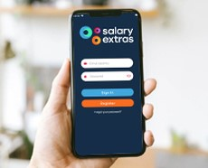

Member Benefits - Discounts
NGSU Extras
NGSU Extras is designed to help you make the most of your membership by providing a great package of savings with some of the best names on the high street and other fantastic offers
Discounted Cinema Tickets
Discounted Gym Membership
Discounted Theme Park Tickets
Instant Discounts including Just Eat and Deliveroo
  now available via an App so you always have access!

Slide 10
NGSU Extras
Adidas | 10% | Harvester | 10% | Primark | 9%
All Bar One | 10% | Google Play | 5% | River Island | 7%
Argos | 5% | H&M | 8% | Sainsbury’s | 4%
Asda | 3% | H Samuel | 7% | Spotify UK | 5%
Ask Italian | 8% | Halfords | 5% | Starbucks | 11%
ASOS | 7% | Home Sense | 9% | Swarovski UK | 16%
B&Q | 4% | Iceland | 3% | TK Maxx | 9%
Beer 52 | 18% | Just Eat UK | 5% | Toby Carvey | 10%
Boohoo | 5% | IKEA | 4% | Tesco | 3%
British Pub Cards | 8%-10% | M&S | 7% | The Entertainer | 4%
Clarks | 9% | Mango | 7% | The White Company | 9%
Costa | 9% | Morrisons & fuel card | 3% | Uber Eats | 3%
Currys PC world | 6% | New Look | 7% | Miller & Carter | 10%
Deliveroo | 4% | Nike | 6% | Zizzi | 8%
Foot locker | 9% | Pizza Hut | 9%
Discounts correct as of 28 Jan 2026 and are subject to change
Also, you can still use your loyalty cards with the retailers

Slide 11
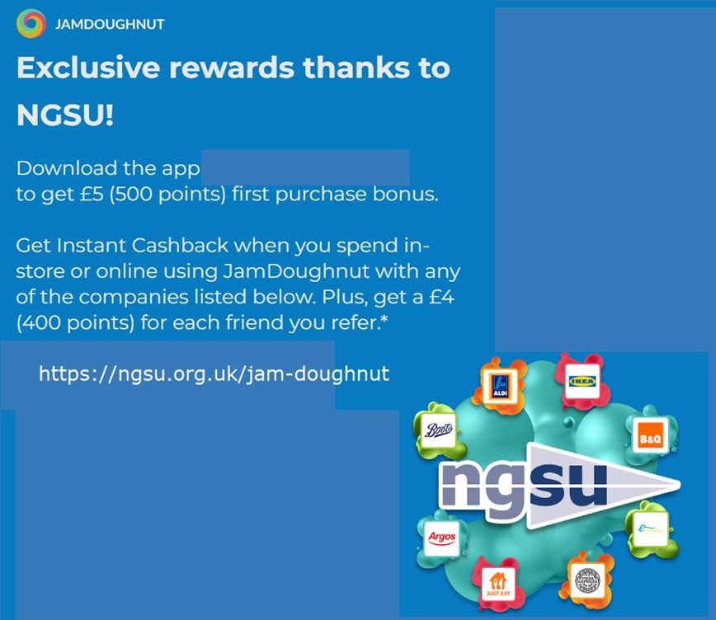
Additional Member Discounts

Slide 12


Additional Member Discounts
Hotpoint VIP
Exclusive to NGSU offer savings of up to 30%. Introducing, the Hotpoint VIP, offering exclusive pricing on Hotpoint, Whirlpool and Indesit products – over 850 different appliances.
Virgin Experience Days
We have teamed up with Virgin Experience Days to offer you an exclusive 15% discount on all full priced experiences.

Slide 13

Additional Member Discounts
NGSU Travel Club – Benchmark Travel
The NGSU Travel Club provides fantastic travel deals and will try to beat ANY OTHER travel agent & website. Also, available for your family
Extra Discount for Members
Summer Breaks
Winter Breaks
Cruises
Wedding & Stag/Hen events

Slide 14

Additional Member Discounts
Holiday Extras
Save up to 10% off travel essentials
Airport Hotel & Parking
Airport Lounges
Car Hire
Airport Fast Track
Port Parking & Hotels
Travel Insurance

Slide 15

Additional Member Discounts

Slide 16

Additional Member Discounts
We have partnered with a specialist company who have been around for over 35 years, who find the best deal for you with a panel of lenders. They do all the hard work, once you have decided what car you would like to lease. They are able offer a wide range of vehicles and have a great reputation for service. (available to family as well!)
.

Slide 17

The Advantage Health Cash Plan
A health cash plan allows you to claim money back, up to set limits, towards the cost of your essential healthcare, as well as providing access to valuable health and wellbeing services.
Dental – money back for check ups, treatments, clean and polish, braces, dentures and more
Doctorline – 24/7 telephone access to a prescribing UK GP, from anywhere in the world
Kids cover – Children are covered on key benefits at no extra cost
Optical – claim for prescription glasses & sunglasses, contact lenses, eye tests & more
Therapy treatments – Cashback for physiotherapy, acupuncture, chiropractic & homeopathy
24 Hour Advice & Info Line – 24/7 telephone access to a counsellor and legal, debt and medical advice
From just £6.91* a month, there are 5 different levels of plan

Slide 18


Additional Member Discounts
Many more discounts available…
We have exclusive discounts with many other companies including…
O2 - 25% Off O2 Refresh 20% discount for family members
Slater & Gordon Solicitors
Advice ’call’ back service
Discounted Legal Documents (including wills)
Personal Injury Claims

Slide 19
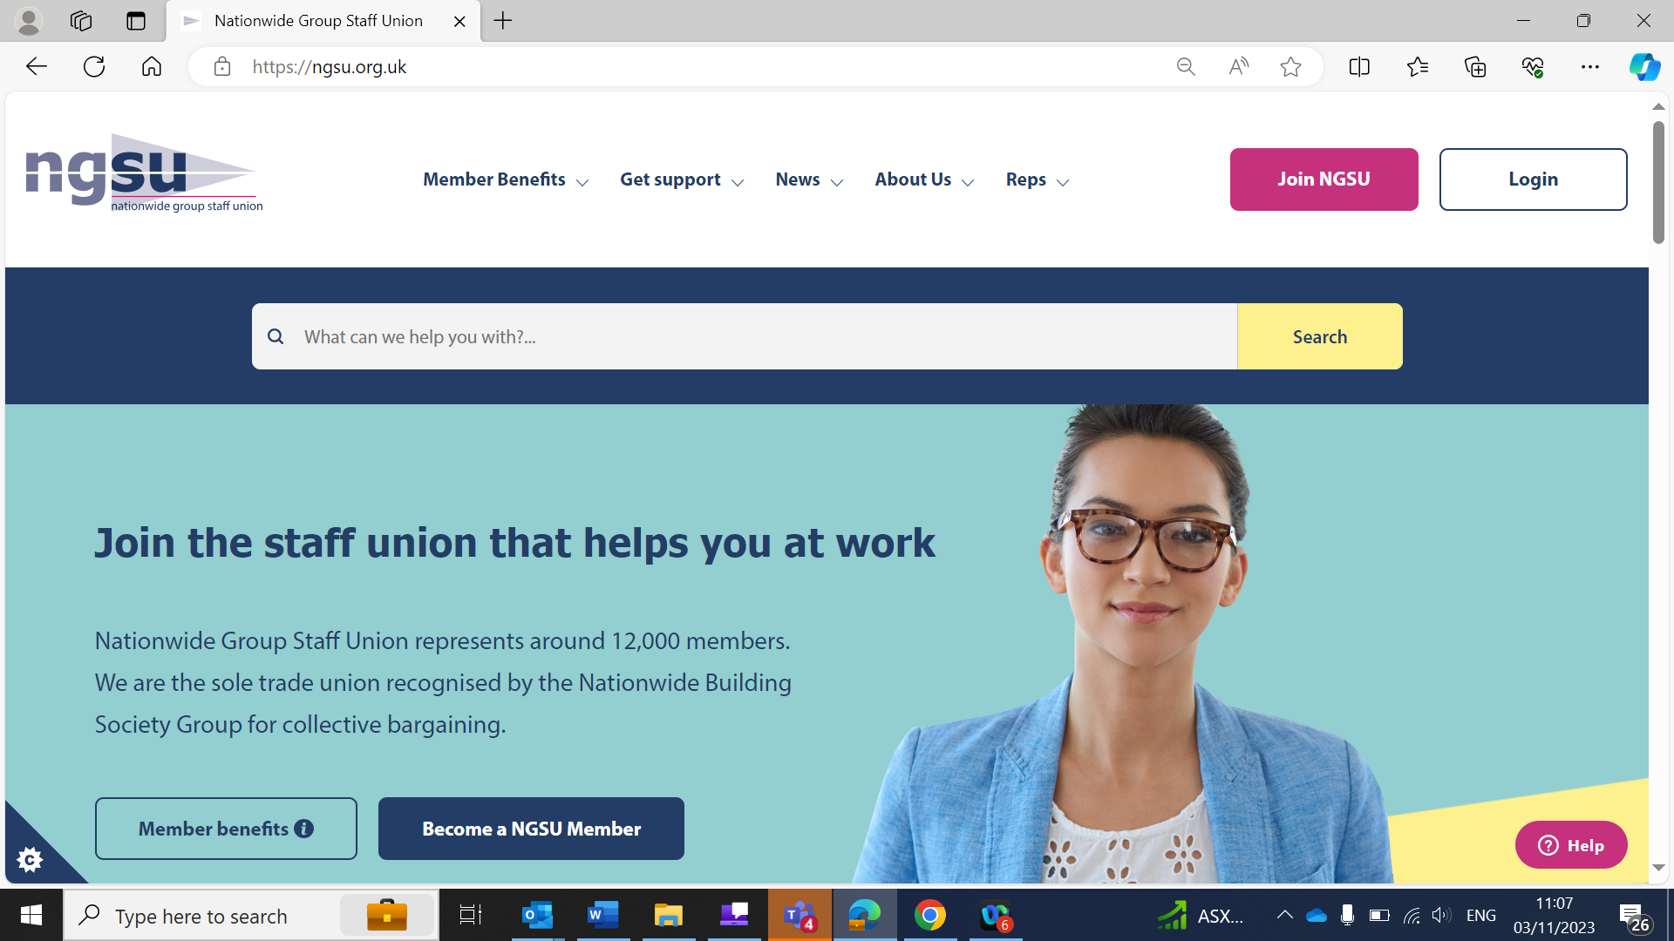
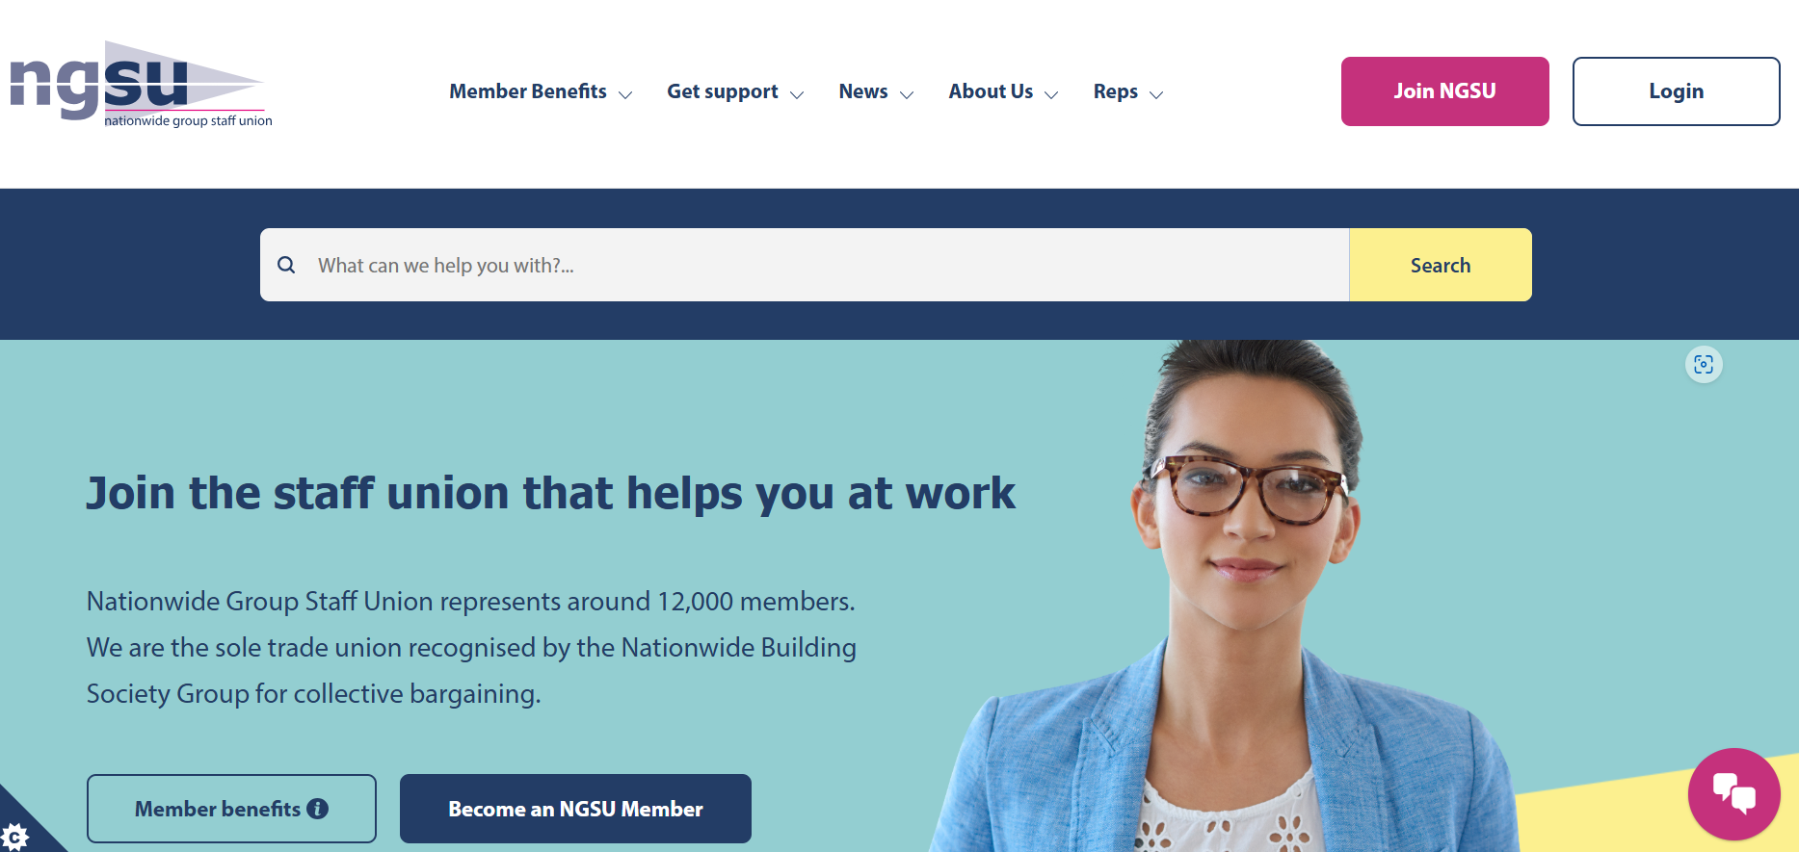
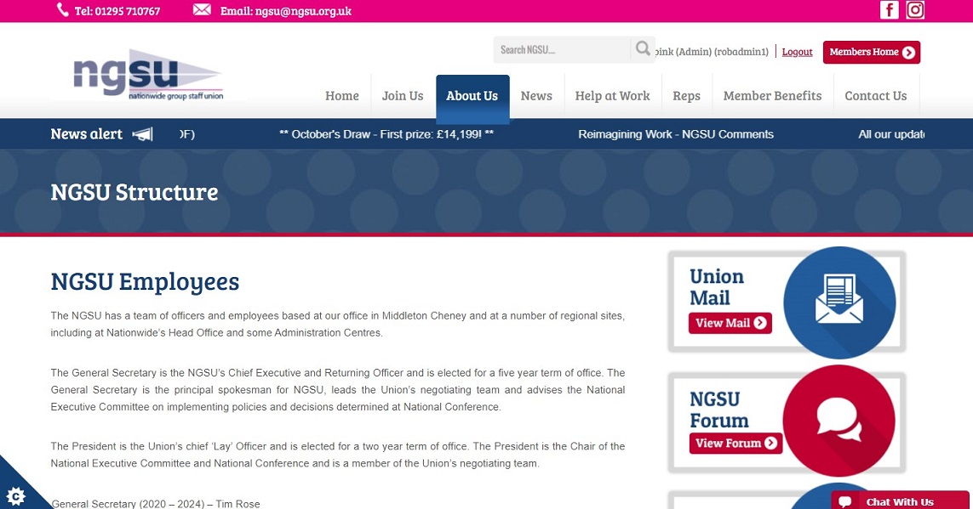
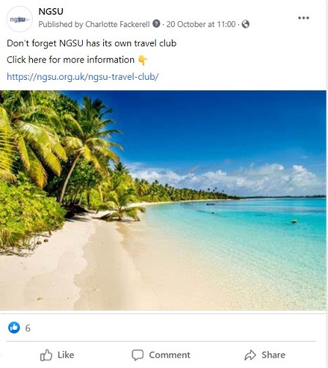
Find Out More
Our Facebook Page:
Facebook - NationwideGroupStaffUnion
Our Website:
https://ngsu.org.uk/

Slide 20

In Summary

Slide 21
Don’t wait until you need advice or help – join today to get the full benefit of Union membership right away!

Slide 22
Thank you!
Any questions?

