Slide 1


Introducing
Nationwide Group Staff Union

Slide 2

About NGSU
Independent TUC Affiliated Trade Union
NGSU is a ‘staff’ union
Around 12,000 members
52 years within NBS
No political affiliation or donations
Dedicated to Protecting Members’ Interests
Negotiating Terms and Conditions
Help and Advice at Work
Individual Representation
Benefits and Discounts

Slide 3
Working with the Admin Centre
Independent Advice At Work
We provide an independent view about employment issues to our members. We also help and support individual members with any problems they may encounter at work
Including:
Pay & Benefits
Terms & Conditions
Performance & Ill Health Meetings
Disciplinary & Request for Resolution (RfR)
Change Programmes
End of Probation Review

Slide 4

What Have The Unions Ever Done For Us?

Slide 5
What Has NGSU Done For Us?
We have worked to negotiate improved rights for employees, including…
Best pay awards in the FS Sector (IDS)
Equal pay
Enhanced maternity & paternity benefits
Flexible working
Pension scheme
Redeployment and severance terms

Slide 6
What Has NGSU Done For Us?
Some Practical Examples
 | Legal Requirement | Nationwide Min
Pay (Hourly) (from 1/4/23) | Over 23 £10.42 21 – 22 £10.18 18 – 20 £7.49
Holiday | 28 days, including public holidays
Sick Pay | From day 4 of sickness, £96/week, for 28 weeks
Maternity Pay | 90% of your weekly earnings, for 6 weeks, then £151.97/week, for 33 weeks

Slide 7
What Has NGSU Done For Us?
Some Practical Examples
 | Legal Requirement | Nationwide Min
Pay (Hourly) (from 1/4/24) | Over 21 £11.44 18 - 20 £8.60 Under 18 £6.40 | £12.63 July 2024
Holiday | 28 days, including public holidays | 32 days including public holidays for England (Scotland & Ireland will vary)
Sick Pay | From day 4 of sickness, £96/week, for 28 weeks | In first 6 months of employment, 2 months’ full pay in 6 months After 6 months’ employment, 6 months’ full pay in 12 months All from 1st day of sickness
Maternity Pay | 90% of your weekly earnings, for 6 weeks, then £151.97/week, for 33 weeks | 100% of weekly earnings, for 26 weeks, then £151.97/week, for 13 weeks

Slide 8
Join Us Today – Together We Are Stronger
Monthly Subscription Fee - from 1st April 2023
Full Time Staff £12.40 p/m
Part Time Staff (16+ hours) £6.80 p/m
Part Time Staff (-16 hours) £5.30 p/m
Maternity & Pensioners £2.90p/m
How do we compare? - @ June 2024
Unite = £17.20 F/T p/m £10.18 P/T p/m
GMB = £14.57 F/T p/m £8.40 P/T p/m
Unison = up to £22.50* p/m
*Linked to salary – rates shown based on equivalent salaries in NBS.

Slide 9

Monthly Subscription Draw
Available To Members Only…
First Prize Of Up To £15,000
Second Prize Of £5,000
Third Prize Of £2,000
Plus Other Prizes ( 3 of £500)
£1 Per Chance, Maximum 10 Chances
Join The Union, And You Could Win!
Total Winnings in 2024:
£281,979!

Slide 10
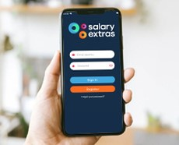

Member Benefits - Discounts
NGSU Extras
NGSU Extras is designed to help you make the most of your membership by providing a great package of savings with some of the best names on the high street and other fantastic offers
Discounted Cinema Tickets
Discounted Gym Membership
Discounted Theme Park Tickets
Reductions on Phone Plans
Instant Discounts including Just Eat and Deliveroo
  now available via an App so you always have access!

Slide 11
NGSU Extras
Adidas | 10% | Harvester | 10% | Primark | 9%
All Bar One | 10% | Google Play | 5% | River Island | 7%
Argos | 5% | H&M | 8% | Sainsbury’s | 4%
Asda | 3% | H Samuel | 7% | Spotify UK | 5%
Ask Italian | 8% | Halfords | 5% | Starbucks | 11%
ASOS | 7% | Home Sense | 9% | Swarovski UK | 16%
B&Q | 4% | Iceland | 3% | TK Maxx | 9%
Beer 52 | 18% | Just Eat UK | 5% | Toby Carvey | 10%
Boohoo | 5% | IKEA | 4% | Tesco | 3%
British Pub Cards | 8%-10% | M&S | 7% | The Entertainer | 4%
Clarks | 9% | Mango | 7% | The White Company | 9%
Costa | 9% | Morrisons & fuel card | 3% | Uber Eats | 3%
Currys PC world | 6% | New Look | 7% | Miller & Carter | 10%
Deliveroo | 4% | Nike | 6% | Zizzi | 8%
Foot locker | 9% | Pizza Hut | 9%
Discounts correct as of 17th January 2025, and are subject to change
Also, you can still use your loyalty cards with the retailers

Slide 12
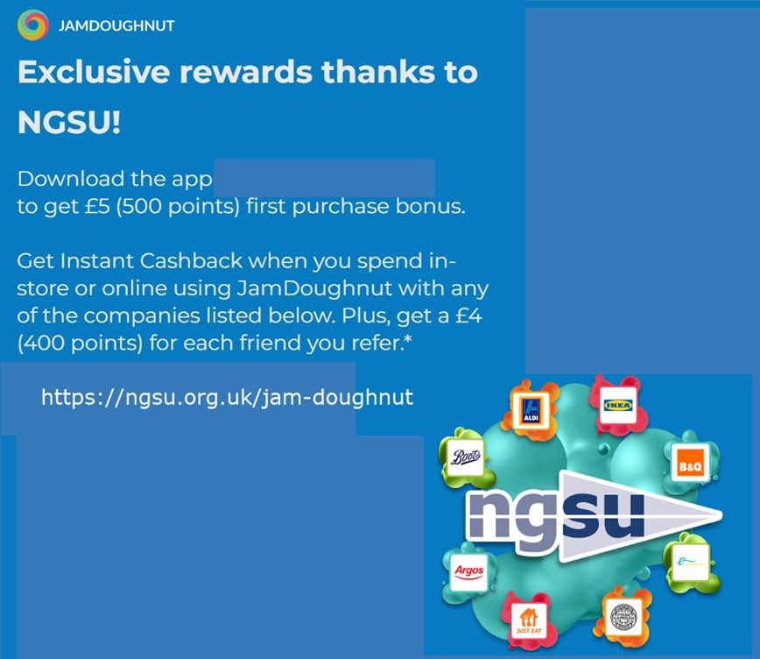
Additional Member Discounts

Slide 13


Additional Member Discounts
Hotpoint VIP
Exclusive to NGSU offer savings of up to 30%. Introducing, the Hotpoint VIP, offering exclusive pricing on Hotpoint, Whirlpool and Indesit products – over 850 different appliances.
Virgin Experience Days
We have teamed up with Virgin Experience Days to offer you an exclusive 15% discount on all full priced experiences.

Slide 14

Additional Member Discounts
Insurance Commission Rebate Scheme
IFS Wealth & Pensions (IFSWP) is an entirely independent company able to offer a Premium Comparison Service to NGSU members and their immediate family. This is a non-advised service in which a cost comparison is provided for insurance policies, such as:
Mortgage Protection (Life and/or Critical Illness)
Critical Illness
Income Protection
Life Assurance
Family Protection
** Receive an exclusive 50% commission rebate for your own policy **

Slide 15

Additional Member Discounts
NGSU Travel Club – Benchmark Travel
The NGSU Travel Club provides fantastic travel deals and will try to beat ANY OTHER travel agent & website. Also, available for your family
Extra Discount for Members
Summer Breaks
Winter Breaks
Cruises
Wedding & Stag/Hen events

Slide 16

Additional Member Discounts
Holiday Extras
Save up to 10% off travel essentials
Airport Hotel & Parking
Airport Lounges
Car Hire
Airport Fast Track
Port Parking & Hotels
Travel Insurance

Slide 17

The Advantage Health Cash Plan
A health cash plan allows you to claim money back, up to set limits, towards the cost of your essential healthcare, as well as providing access to valuable health and wellbeing services.
Dental – money back for check ups, treatments, clean and polish, braces, dentures and more
Doctorline – 24/7 telephone access to a prescribing UK GP, from anywhere in the world
Kids cover – Children are covered on key benefits at no extra cost
Optical – claim for prescription glasses & sunglasses, contact lenses, eye tests & more
Therapy treatments – Cashback for physiotherapy, acupuncture, chiropractic & homeopathy
24 Hour Advice & Info Line – 24/7 telephone access to a counsellor and legal, debt and medical advice
From just £6.52** a month, there are 5 different levels of plan

Slide 18


Additional Member Discounts
Many more discounts available…
We have exclusive discounts with many other companies including…
O2 - 25% Off O2 Refresh 20% discount for family members
Slater & Gordon Solicitors
Free Legal Helpline (available for family too)
Discounted Legal Documents (including wills)

Slide 19
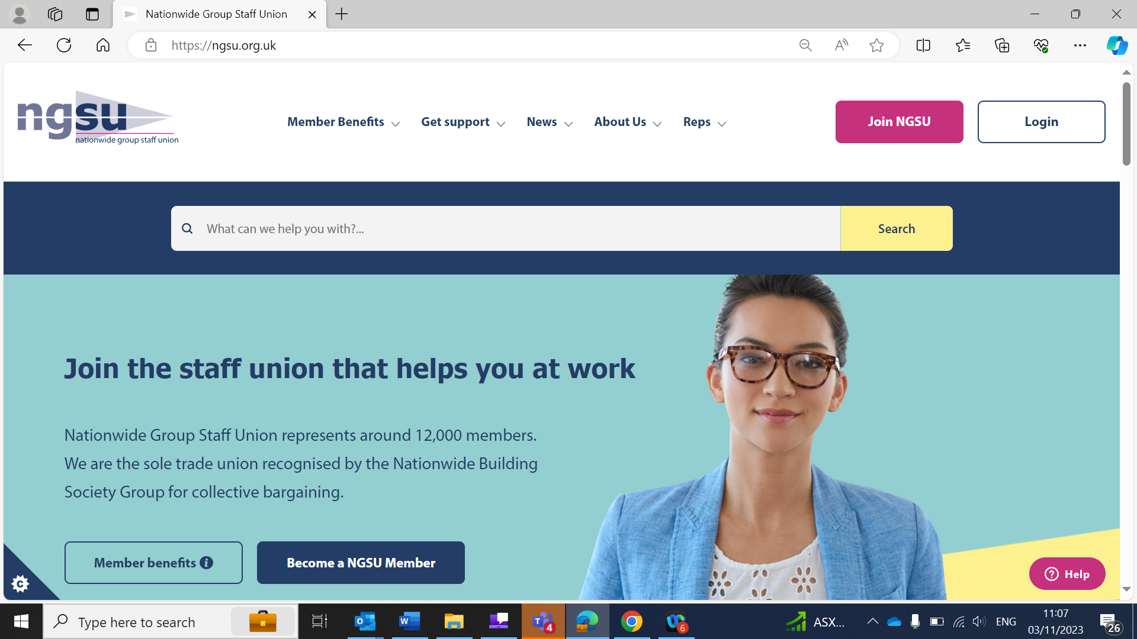
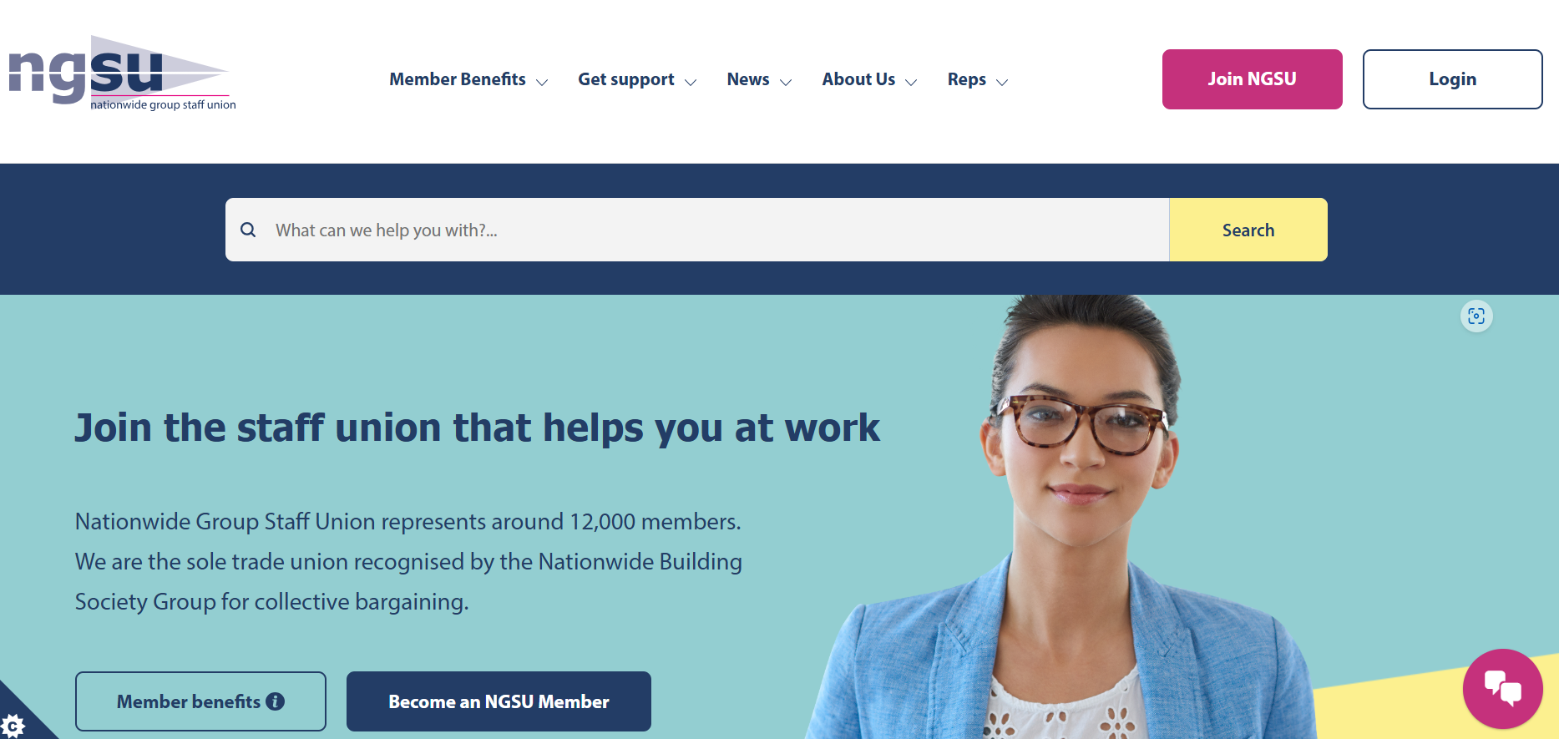
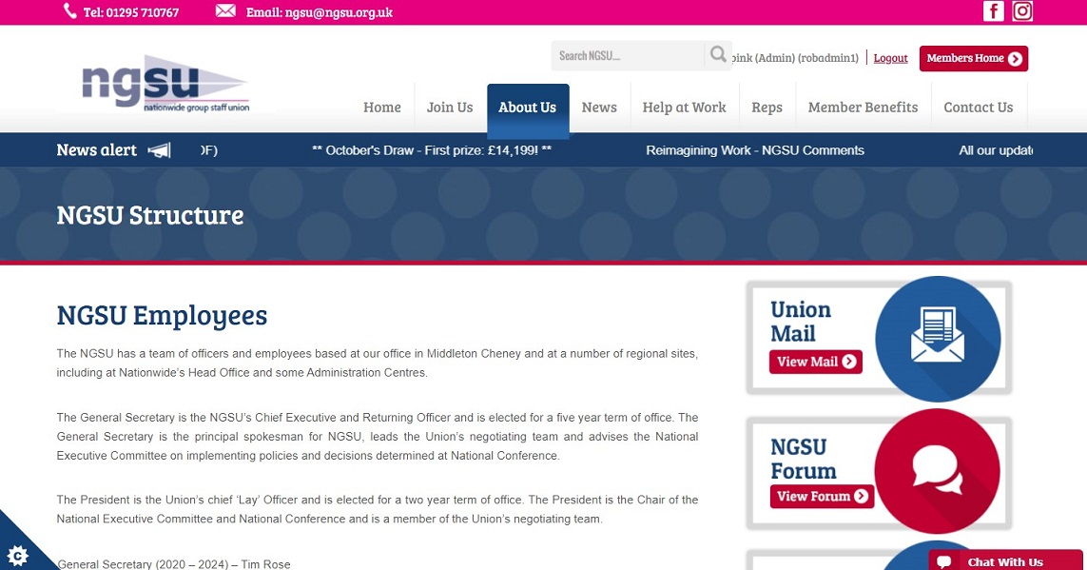
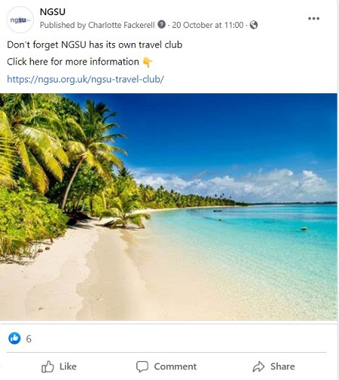
Find Out More
Our Facebook Page:
Facebook - NationwideGroupStaffUnion
Our Website:
https://ngsu.org.uk/

Slide 20

In Summary

Slide 21
Don’t wait until you need advice or help – join today to get the full benefit of Union membership right away!

